Slide 1
Unity Networking
With Unity’s high-level API

Slide 2
Overview
NetworkIdentity
NetworkTransforms
NetworkBehavior
Commands, RPC, SyncVar
Network Manager
Network Player

Slide 3
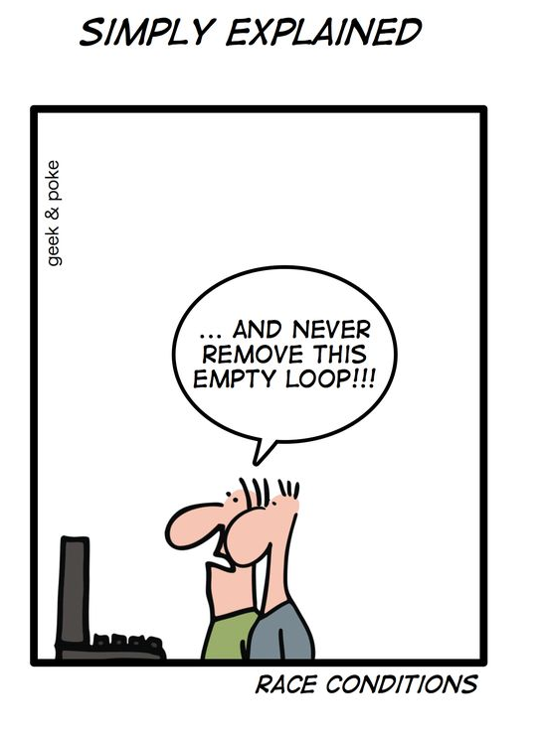
Important things to remember for testing and design
At many times things will work in the editor and not work in the built version
Order of equal priority events is not guaranteed by default and is almost always different in the built version than the editor

Slide 4
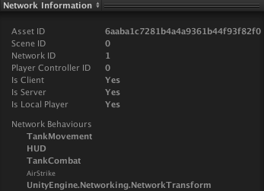
Network Identity
Required on all network objects
Must be placed at the highest level of the hierarchy
Contains unique identifier property
Links
https://docs.unity3d.com/Manual/class-NetworkIdentity.html
https://docs.unity3d.com/ScriptReference/Networking.NetworkIdentity.html

Slide 5
Network Transforms
By placing this component on an object its position and rotation will automatically be synchronized across the network at a specified interval.
Objects must have a network Identity
Must be at the top level of the hierarchy
In order to track child objects, use network transform child (must also be on the top level)
Cannot be set at runtime
Links
https://docs.unity3d.com/Manual/class-NetworkTransform.html
https://docs.unity3d.com/ScriptReference/Networking.NetworkTransform.html

Slide 6
Network Behavior
Required class to inherit from when utilizing HLAPI networking
Links
https://docs.unity3d.com/Manual/class-NetworkBehaviour.html
https://docs.unity3d.com/ScriptReference/Networking.NetworkBehaviour.html

Slide 7
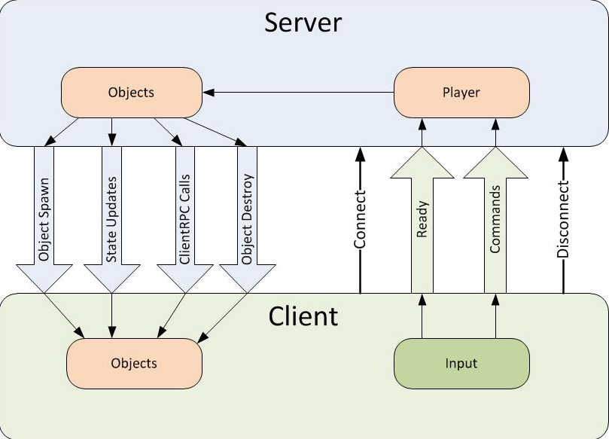
Remote Actions
Links
https://docs.unity3d.com/Manual/UNetActions.html

Slide 8
Commands
Example
[Command]
public void CmdMove(int x, int y)
{
moveX = x;
moveY = y;
isDirty = true;
}
Links
https://docs.unity3d.com/ScriptReference/Networking.CommandAttribute.html

Slide 9
RPC
Example
[ClientRpc]
public void RpcDoMagic(int extra)
{
Debug.Log("Magic = " + (123 + extra));
}
Links
https://docs.unity3d.com/ScriptReference/Networking.ClientRpcAttribute.html

Slide 10
SyncVar
Example
public class Ship : NetworkBehaviour
{
[SyncVar]
public int health = 100;
[SyncVar]
public float energy = 100;
}
Hooks
Types
Basic type (byte, int, float, string, UInt64, etc)
Built-in Unity math type (Vector3, Quaternion, etc),
Structs containing allowable types .
Links
https://docs.unity3d.com/ScriptReference/Networking.SyncVarAttribute.html

Slide 11
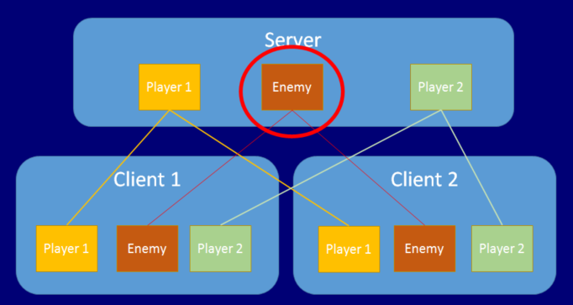
Network Player
Client Authority
Commands
Instanced on every client
Special Methods
OnStartClient
OnLocalPlayerStart
OnStartServer
Special Properties
isClient
isLocalPlayer
isServer
Links
https://docs.unity3d.com/Manual/UNetConcepts.html
https://docs.unity3d.com/Manual/UNetPlayers.html
https://docs.unity3d.com/Manual/NetworkManagerCallbacks.html
https://docs.unity3d.com/Manual/NetworkBehaviourCallbacks.html

Slide 12
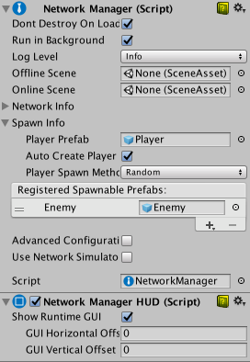
Network Manager
Contains and registers spawnable objects
Contains Player Object
Manages Connections, start and stop client or server
Links
https://docs.unity3d.com/Manual/UNetManager.html
https://docs.unity3d.com/ScriptReference/Networking.NetworkManager.html

Slide 13
Spawning
Spawnable object needs to be registered on the NetworkManager
Order to spawn: Instantiate -> Spawn
Custom spawners are also available (e.g. if you are spawning items that are loaded in from asset bundles)
Links
https://docs.unity3d.com/Manual/UNetSpawning.html
https://docs.unity3d.com/Manual/UNetCustomSpawning.html

